Slide 1
Research methodology & process dr. alka Jain h.o.d. food & nutrition deptt. govt. R.m.d. Girls p.g. College ambikapur surguja chhattisgarh

Slide 13
Summary writing

Slide 15
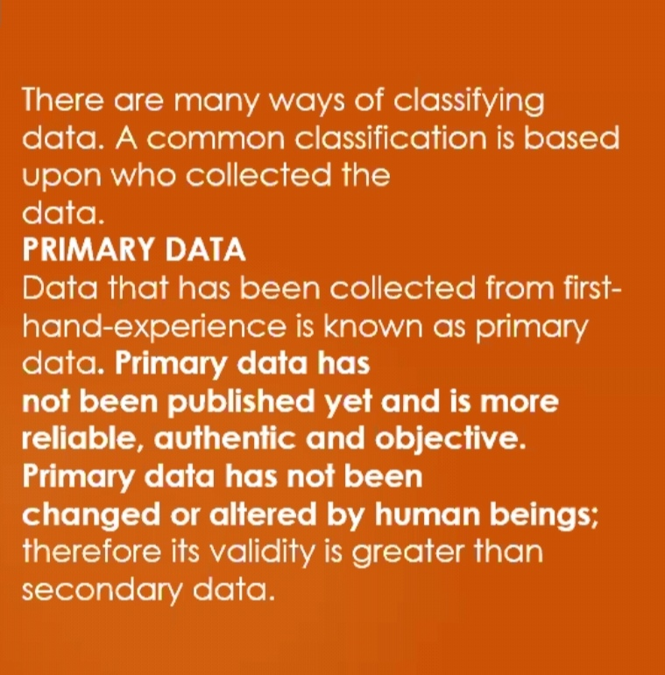

Slide 20
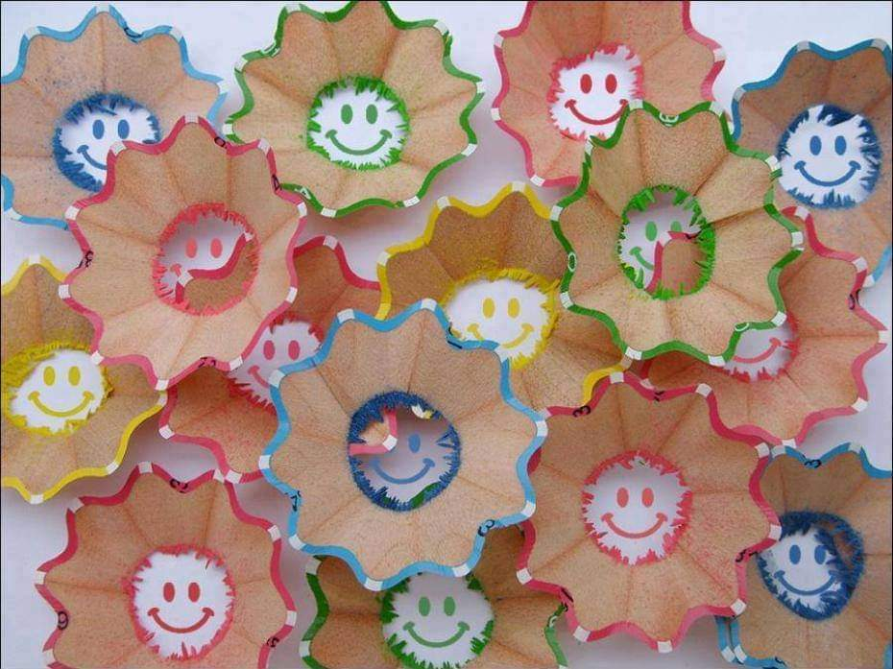
Thank you.

