Slide 1
Nutrition for well being.
Dr.Alka Jain Asstt .Prof.& H.O.D. Home Science Govt.R.M.D.Girls P.G.college Ambikapur

Slide 2
Balanced diet
Calorie intake as per age ,sex,&activity
Protein intake 1 gm./kg .Body weight
Oral fat 22gms /day
Sufficient carbohydrate 60% of non protein calorie
Diet must contain all vitamins n minerals
Adequate water &Fibre intake.
Regular intake of vitamin B complex & vitamin c

Slide 3
Food habits & existing trends now a days
Increased intake of Fast food &junk food
Fatty &fried food intake
Lack of excercise & sedentary life style
Mental stress & haphazard living
Irregular sleeping pattern Irregular eating pattern

Slide 4
Problems of college going girls
Anaemia
Undernutrition
Anorexia nervosa
Tiredness
Headache
Migraine DigestiveProblem
Overnutritiion
Acne

Slide 5
Tips to strengthen immunity.
Eat regularly healthy meals.eat rainbow foods, include immunity boosters.
Regular exercise atleast 30 minutes/day
Practice relaxation techniques such as yoga,meditation,,deep breathing, laughing
Practice time management to avoid stress.
Keep your attitude positive.
Talk about your problems to your well wishers.
Walking ,gardening,listening music.
Proper sleep.
Identify the cause of your stress.Pass it.

Slide 6
Specific Nutrients For immunity booster
Protein
Vitamin A,B complex,C,D,E
Zn,selenium
Probiotics,prebiotics Antioxidants Poly phenols

Slide 10
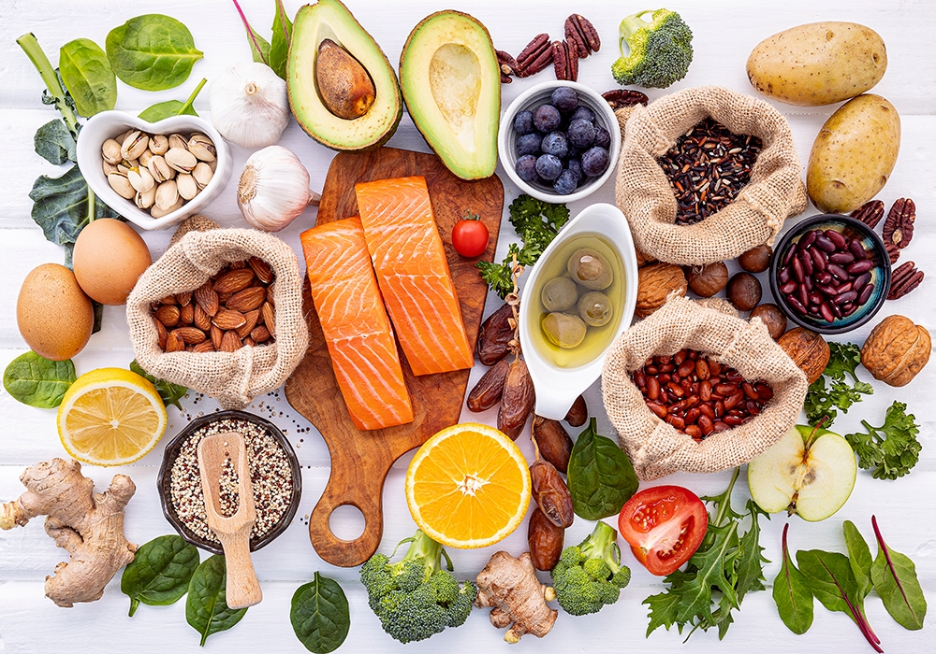
Food that boost your immunity
Nuts
Tulsi ,Honey, Turmeric
Citrus fruits,amla
Garlic,ginger
Spirulina Red &yellow bell pepper
Curd,dairy products
Sunflower seeds
Green tea
Papaya,kisi berries
Broccoli, Mushrooms,
Leafy vegetables
Egg,poultry ,shell fish
Dark chocolates

Slide 11
Vitality booster
Proper sleep
Deep breathing
Fresh air
Breakfast contain whole grains,cereals porridge,fresh fruits,curd,Or milk

Slide 12
Immunity booster foods

Slide 13
Eat healthy stay healthy.
ThanK you.

